Slide 1


Introduction to Programming
Introduction
Coming together is a beginning. Keeping together is progress. Working together is success.
Henry Ford

Slide 2
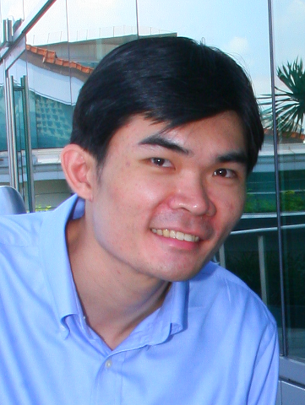
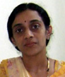
Instructors (G7)
LEE Yeow Leong
Office: SIS Level 4, Room 4053
Phone/Whatsapp/Telegram: 9668 7246
Consultation: By Appointment
Vandana R Rao
Office: SIS Level 4, Room 4033
Phone: 6828 0230
Consultation: By Appointment
Notes:
1. tue 12nn: weixiang, qixun(YL + VR)
2. thu 12nn: aaron, Yiding (YL + LC)
3. thu 3:30pm: Zijie, Hong Yang (YL + VR)

Slide 3
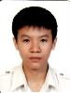
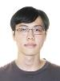
Teaching Assistants (G6)
YEO Qi Xun
Email ID: qixun.yeo.2016
KER Wei Xiang
Email ID: wxker.2016

Slide 4
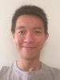
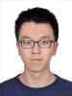
Teaching Assistants (G4)
Aaron TEO Wee Kiat
Email ID: aaron.teo.2016
WANG Yiding
Email ID: yiding.wang.2016

Slide 5
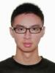
Teaching Assistants (G5)
TOH Zi Jie
Email ID: zijie.toh.2016
HONG Yang
Email ID: hong.yang.2016

Slide 6

Course Objectives
Upon completion of the course, students will be able to:
Understand and apply the basic programming concepts to solve problems
Understand and use two important data structures: list and dictionary
Write simple Python scripts to handle simple tasks

Slide 7

Tentative Lesson Plan
 | Topic | Punch | Gaddis
1 | Variables, Expressions & Statements | Chapter 1 | Chapter 1 & 2
2 | Control (Conditionals & for loops) | Chapter 2 | Chapter 3 & 4
3 | Object Manipulation (String) | Chapter 4 | Chapter 8
4 | functions | Chapter 5 | Chapter 5
5 | Exercises (No new topic)
6 | While loops | Chapter 2 | Chapter 4
7 | Lists and Tuples | Chapter 7 | Chapter 7
8 | Term Break
9 | Files | Chapter 6.1 - 6.5 | Chapter 6
10 | Dictionaries | Chapter 9.1 - 9.3 | Chapter 9.1
11 | 2-Dimensional Data structures
12 | Revision
13 | Revision

Slide 8

Assessment
Wk | Output Assessments | Weighting in % | Group Weighting
1 |  |  | Lab Test: 50% Class Participation: 10% pop quizzes (start of class) instructor's evaluation Exam: 40%
2
3
4
5
6 | Lab Test 1 [ 29 Sep, Fri, 3:30pm – 5pm ] | 20
7
8 | Term Break
9
10
11
12
13
14 | Lab Test 2 [ 20 Nov, Mon, 9:15am – 11:15am ] | 30
15 | Final Exam [ 27 Nov, Mon, 8:30am – 10:30am ] | 40

Slide 9
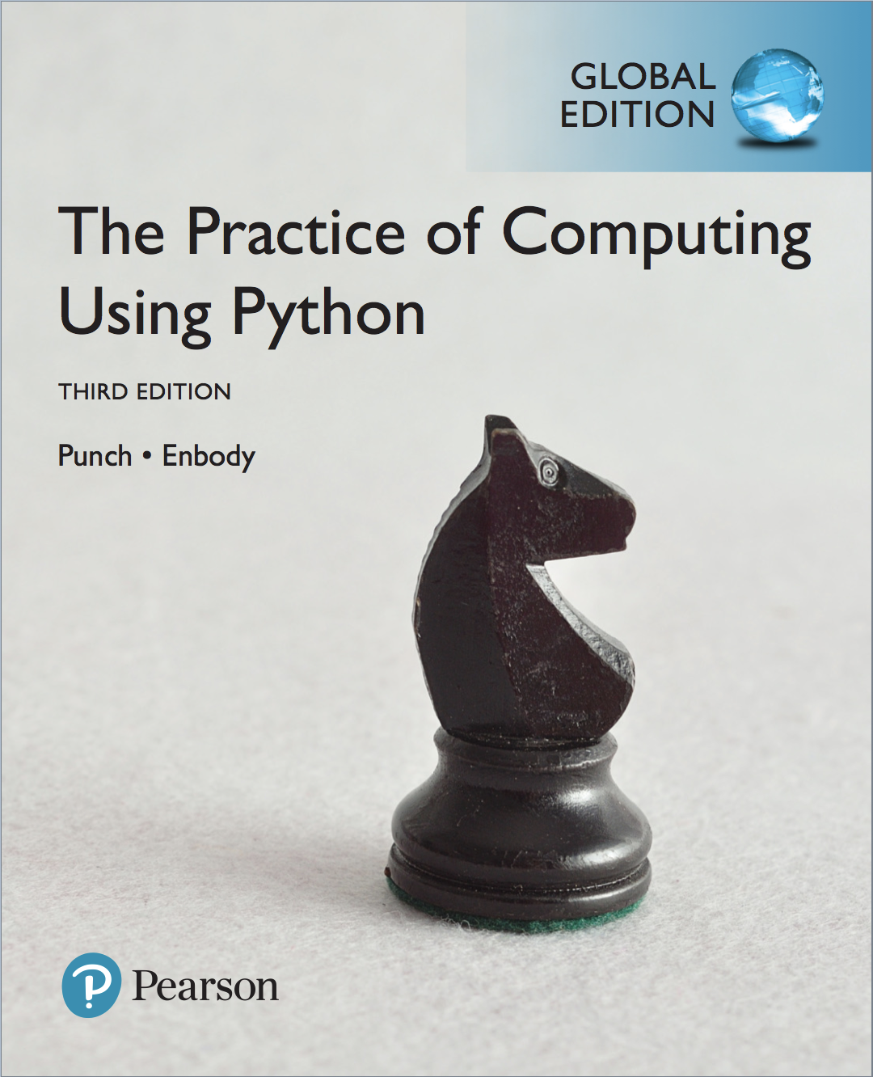

Reference Texts
The Practice of Computing Using Python
Author: William F Punch, Richard Enbody
ISBN13: 978-0134380315
Starting Out with Python
Author: Tony Gaddis
ISBN13: 978-1292065502

Slide 10

Class Participation
"Delivering an interactive, participative and technologically-enabled learning experience"
You (as a student)
Be prepared for class
Have a positive impact on collaborative learning
Contribute and share what you know
Discuss and work in a team
Be professional
No hijacking the airwaves
Give due respect to your peers (listen when they talk)
Me (as an instructor)
My responsibility and professional duty to assess you

Slide 11
Course Policies
Assessments
if you miss any of the lab tests
with valid reason: I grade
No reason: 0 mark
Submission Policy
Submit ALL deliverables through eLearn LMS
There is a penalty for late submission!

Slide 12

Academic Integrity
All acts of academic dishonesty (including, but not limited to, plagarism, cheating, fabrication, facilitation of acts of academic dishonesty by others, unauthorized possession of exam questions, or tampering with the academic work of other students) are serious offences.
All work (whether oral or written) submitted for purposes of assessment must be the student’s own work. Penalties for violation of the policy range from zero marks for the component assessment to expulsion, depending on the nature of the offence.
When in doubt, students should consult the instructors of the course.
Details on the SMU code of Academic Integrity may be accessed at http://www.smuscd.org/resources.html.

Slide 13



Tools http://blue.smu.edu.sg/installer
Software
Python 3
https://www.python.org/downloads
Visual Studio Code
https://code.visualstudio.com

Slide 14
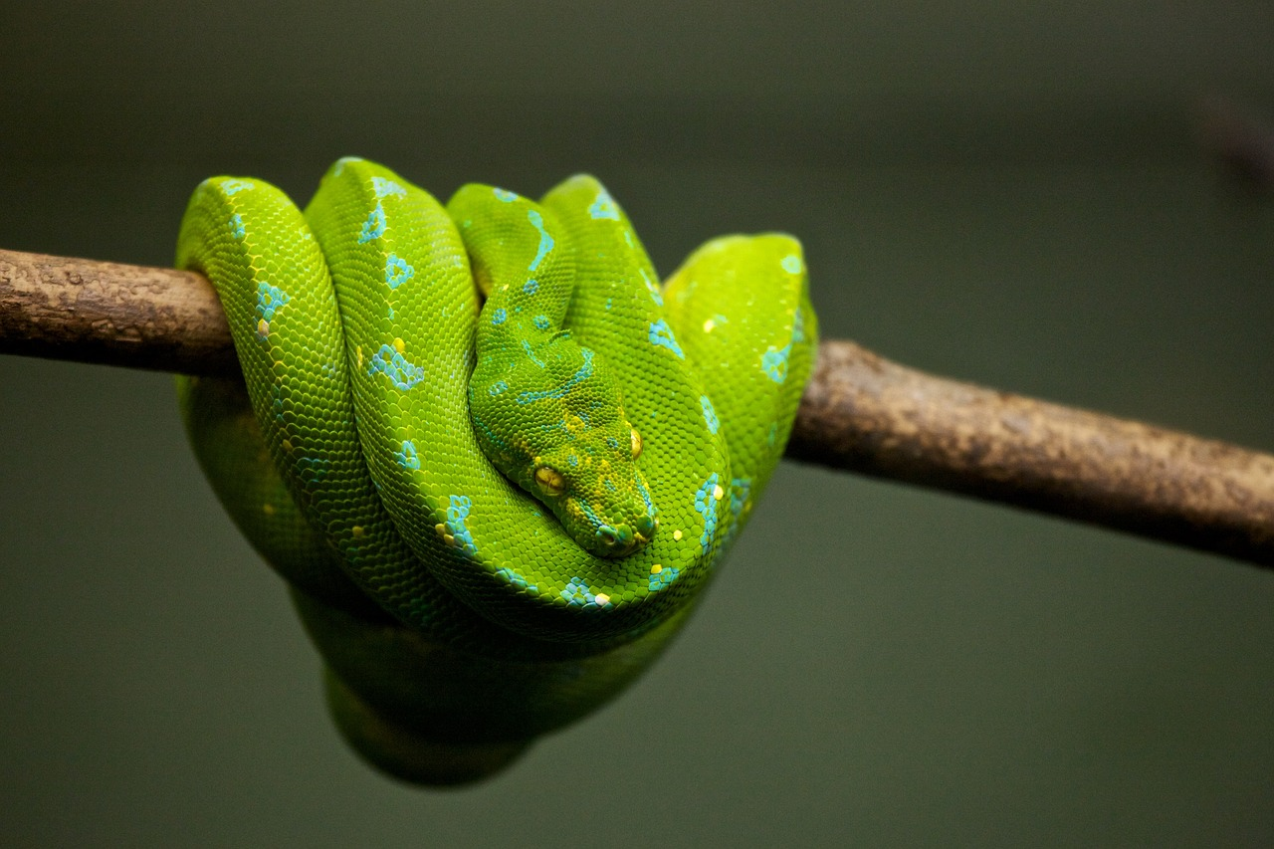
References
Think Python
http://greenteapress.com/thinkpython2/html/index.html
How To Think Like a Computer Scientist
http://interactivepython.org/runestone/static/thinkcspy/index.html
A Byte of Python
https://python.swaroopch.com

Slide 15
eLearn LMS
http://elearn.smu.edu.sg
Used for
Downloading lecture slides and labs
Submitting the individual assignment
Q & A
Checking grades

Slide 16
Survival Tips
Before class
Read the slides/textbook before coming to class!
In class
Clarify doubts
Pay attention
Take notes
http://www.youtube.com/watch?v=WtW9IyE04OQ
After class
Revise your notes
Practice, practice & practice

Slide 17


Most Importantly …
Work hard but have fun!

